Slide 1
Journey
to the
Heart of God

Slide 2
Show me the right path, O Lord;
point out the road for me to follow.
Psalm 25:4

Slide 3
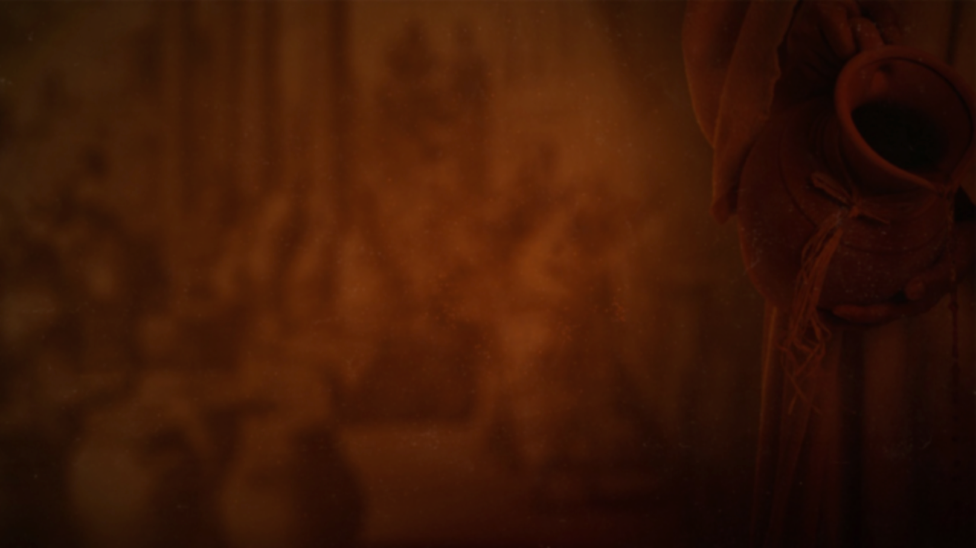
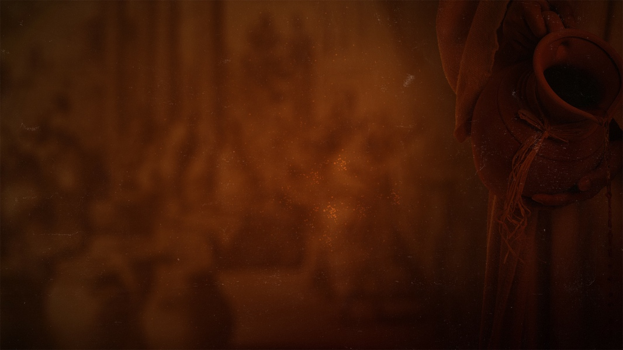
“There is a God shaped vacuum in the heart of every man which cannot be filled by any created thing, but only by God, the Creator, made known through Jesus.”
Blaise Pascal

Slide 4
He who did not spare his own Son
but gave him up for us all,
how will he not also with him graciously
give us all things?
Romans 8:32 ESV

Slide 5
The Lord has made the heavens his throne;
from there he rules over everything.
Ps 103:19
“I am the first and the last; there is no other God.
Who is like me? Let him step forward
and prove his power.”
Is 44:6-7
The Lord does whatever pleases him
throughout heaven and earth.
Ps 135:6

Slide 6
The Lord is my shepherd;
I have all that I need.
Psalm 23:1

Slide 7
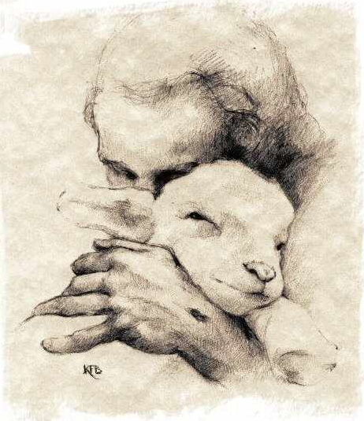

Slide 8
…He who holds the universe in His hand
as though it were a very little thing,—He
is your shepherd, and has charged Himself
with the care and keeping of you…
H. W. Smith

Slide 9
Need - a necessity

Slide 10
“God designed the human machine to run
on Himself. He Himself is the fuel our
spirits were designed to burn, or the food
our spirits were designed to feed on.
There is no other.”
C. S. Lewis

Slide 11
Want - a desire

Slide 12
God is a wise Father who sometimes
refuses what you want —
to give you
what you need.
H. B. Charles, Jr

Slide 13
May I not do what I like with what
belongs to me? Must you be jealous
because I am generous?
Matthew 20:15 Phillips

Slide 14
It never crossed my mind that he [the landowner]
might have acted on the supposition that those
who had worked in the vineyard the whole day
would be deeply grateful to have had the
opportunity to do work for their boss, and
even more grateful to see what a generous
man he was.
Henri J. M. Nouwen

Slide 15
It does little good for us to object to
what He chooses to do.
When He said to Moses,
“I AM that I AM”
He in effect said,
“I am Who I am and not Who you
would prefer Me to be.”
Erwin W. Lutzer

Slide 16
If God is for us,
who can be against us?
Romans 8:31

Slide 17
So to keep me from becoming proud, I was
given a thorn in my flesh…
2 Corinthians 12:7

Slide 18
And we know that God causes everything to
work together for the good of those
who love God and are called
according to his purpose for them.
For God knew his people in advance,
and he chose them to become like
His Son…
Romans 8:28-29

Slide 19
Not until history has run its course will
we understand how “all things work
together for good.”
Faith means believing in advance what
will only make sense in reverse.
Philip Yancey

Slide 20
Always He is trying to get our attention,
to reveal Himself to us,
to communicate with us.
A. W. Tozer

Slide 21
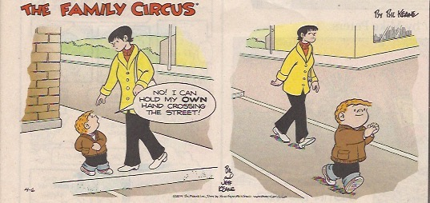

Slide 22
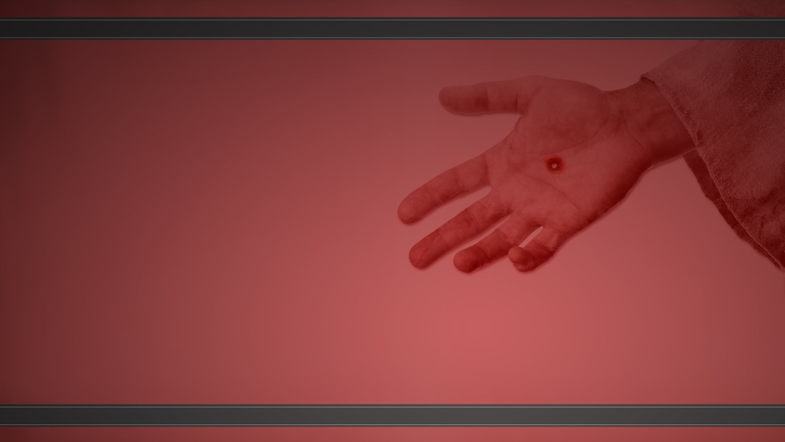
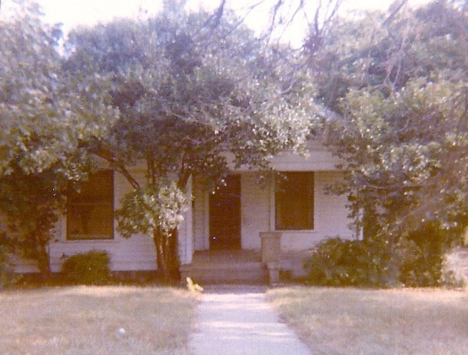

Slide 23
The Father spoke:
Come, child, let us journey together.
Where shall we go, Father?
To a distant land, another kingdom.
So the journey will be long?
Yes, we must travel every day.
When will we reach our destination?
At the end of your days.
And who will accompany us?
Joy and sorrow.
Must sorrow travel with us?
Yes, she is necessary to keep you close to Me.
But I want only Joy.
It is only with Sorrow that you will know
true joy.

Slide 24
What must I bring?
A willing heart to follow Me.
What shall I do on the journey?
There is only one thing that you must do—
stay close to Me. Let nothing distract you.
Always keep your eyes on Me.
And what will I see?
You will see My glory.
And what will I know?
You will know my heart.
The Father stretched out His hand. The child
knowing the great love her Father had for her,
placed her hand in His and they began their
journey.

Slide 25
I have been crucified with Christ;
and it is no longer I who live,
but Christ lives in me; and the
life I now live in the flesh I live
by faith in the Son of God who
loved me and delivered Himself
up for me.
Galatians 2:20

Slide 26
There are three marks of one who
is crucified.
One, he is facing in only one direction.
Two, he can never turn back.
And three, he no longer
has any plans of his own.
A. W. Tozer

Slide 27
The Father spoke:
Are you ready, my child?
Yes, but I have nothing to bring except myself.
You are all I need.
Surely I must bring something: I do not feel
prepared to travel.
Do not concern yourself with preparations.
Your journey has already begun.
But I am fearful.

Slide 28
There is no need to fear; I will always
be with you.
Will You give me what I need?
I will provide for you.
What will you provide?
All that is essential for your journey.
And what is essential?
I will show you along the way. For now,
you have what is necessary:
the desire to draw near to My heart.

Slide 29
Journey
to the
Heart of God

Slide 30
Show me the right path, O Lord;
point out the road for me to follow.
Psalm 25:4

Slide 31
Man needs to be alone with God.
Without this, God cannot have the
opportunity to shine into his heart,
to transform his nature by His divine
working, to take possession and to
fill him with the fullness of God.
Andrew Murray

Slide 32
My heart has heard you say,
“Come and talk with me.”
And my heart responds,
“Lord, I am coming.”
Psalm 27:8
“Come to me, all of you who are weary and
carry heavy burdens, and I will give you rest.
Matthew 11:28

Slide 33
Her sister, Mary, sat at the Lord’s
feet, listening to what he taught.
But Martha was distracted by the
big dinner she was preparing.
Luke 10:39-40

Slide 34
But the Lord said to her, “Martha, Martha,
you are worried and upset over all these
details! There is only one thing worth being
concerned about. Mary has discovered it,
and it will not be taken away from her.
Luke 10:41

Slide 35
Many today are spending and being
spent in work for Christ, but they
do not walk with Him.
Oswald Chambers

Slide 36
In our Lord’s life there was none of the press
and rush of tremendous activity that we
regard so highly, and the disciple is to be
as His Master.
The central thing about the
kingdom of Jesus Christ is a personal
relationship to Himself, not public
usefulness to men.
Oswald Chambers

Slide 37
Yes, all the things I once thought were so
important are gone from my life.
Compared to the high privilege of knowing
Christ Jesus as my Master, firsthand,
everything I once thought I had going
for me is insignificant...
Philippians 3:8 MSG

Slide 38
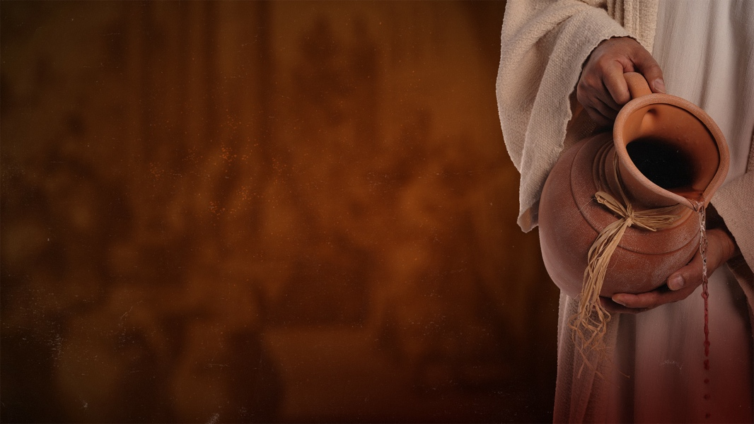
I am the vine, you are the branches;
he who abides in Me and I in him,
he bears much fruit, for apart from
Me you can do nothing.
John 15:5

Slide 39
Abiding -
consistently
sitting at the feet of Jesus
listening to His words
with a heart to obey.
Keeping your hand in His~

Slide 40
Abram traveled southward and
pitched his tent between Bethel on
the west and Ai on the east.
There he built an altar and
worshiped the Lord.
Genesis 12:8

Slide 41
Bethel is the symbol of communion with God;
Ai is the symbol of the world.
Abraham pitched his tent between the two.
The measure of the worth of our public activity for
God is the private profound communion we have
with Him. Rush is wrong every time, there is
always plenty of time to worship God.
Quiet days with God may be a snare.
We have to pitch our tents where we shall
always have quiet times with God, however
noisy our times with the world may be.
Oswald Chambers

Slide 42
Job 23:12 ~ ...I have treasured the words of
His mouth more than my daily food.
Jeremiah 15:16 ~ Your words were found,
and I ate them.
Your words became a delight to me
and the joy of my heart...
Matthew 4:4 ~ But He answered, “It is
written: Man must not live by bread
alone but by every word that comes
from the mouth of God.”

Slide 43
Dear child of God, let us never say,
“I have no time for God.” Let the Holy
Spirit teach us that the most important,
the most blessed, the most profitable time
of the whole day is the time we spend
alone with God...Whatever else is left
undone, God has the first and chief
right to my time.
Andrew Murray

Slide 44
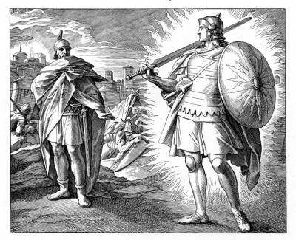
Joshua went up to him and demanded, “Are you friend or foe?”
“Neither one”, he replied. “I am commander of the Lord’s army.”
At this, Joshua fell with his face to the ground in reverence.
Joshua 5:13-14

Slide 45
“I am at your command,”
Joshua said.
“What do you want me to do?”
Joshua 5:14

Slide 46
My heart has heard you say,
“Come and talk with me.”
Psalm 27:8
“Come to me, all of you who are weary and
carry heavy burdens, and I will give you rest.
Matthew 11:28

Slide 47
RSVP
Thank you for your gracious invitation to
spend time with You. I cannot accept because
________________________________
________________________________

Slide 48
Thank you for your gracious invitation to
spend time with You, my heart responds,
“Lord, I am coming”

Slide 49
Journey
to the
Heart of God

Slide 50
Show me the right path, O Lord;
point out the road for me to follow.
Psalm 25:4

Slide 53
Wherever you go, I will go;
wherever you live, I will live.
Your people will be my people,
and your God will be my God.
Ruth 1:16

Slide 54
So Ruth went out to gather grain
behind the harvesters. And it
happened, she found herself
working in the field that
belonged to Boaz, the relative
of her father-in-law, Elimelech.
While she was there, Boaz
arrived from Bethlehem…
Ruth 2:3-4

Slide 55
I know about everything you have done
for your mother-in-law since the death
of your husband. I have heard how you
left your father and mother and your
own land to live here among complete
strangers. May the Lord, the God of
Israel, under whose wings you have
come to seek refuge, reward you fully
for what you have done.
Ruth 2:11-12

Slide 56
As soon as you begin to live the
life of faith in God, fascinating
and luxurious prospects will open
before you, and these things are
yours by right; but if you are living
the life of faith you will exercise your
right to waive your rights, and
let God choose for you.
Oswald Chambers

Slide 58
Then the women of the town said to
Naomi, “Praise the Lord, who has now
provided a redeemer for your family!
May he restore your youth and care for
you in your old age. For he is the son of
your daughter-in-law who loves you and
has been better to you than seven sons!”
Ruth 4:14-15

Slide 59
This is what the Lord says—
your Redeemer, the Holy One
of Israel: “I am the Lord your
God, who teaches you what is
good for you and leads you along
the paths you should follow.”
Isaiah 48:17

Slide 60
How to let God choose for you
1) Let the Lord be your shepherd
2) Pray and wait for God’s leading and peace
Your own ears will hear him. Right behind you a voice
will say, “This is the way you should go…”
(Isaiah 30:21)

Slide 61
When in doubt, don’t
Keep going until He checks

Slide 62
“To know the will of God,
you should have no will of your own.”

Slide 63
Beloved, whenever you are in doubt as to
which way to turn, submit your judgment
absolutely to the Spirit of God, asking Him
to shut every door but the right one.
Say to Him, “Blessed Spirit, I give to You the
entire responsibility of closing every road and
stopping every step that is not of God. Let me
hear Your voice behind me whenever I turn
aside to the right or to the left.”
Streams in the Desert

Slide 64
Hold on to the faithfulness of God.
Believe, when you do not understand,
that he knows all about you, that he
is committed to taking care of you.
He has promised it.
D. Martyn Lloyd-Jones

Slide 65
God always gives His best
to those who leave the
choice with Him.
Jim Elliot

Slide 66
Christian contentment is that sweet,
inward, quiet, gracious frame of spirit,
which freely submits to and delights in
God’s wise and fatherly disposal in
every condition.
Jeremiah Burroughs

Slide 67
Not that I was ever in need, for I have learned how to be content with whatever I have.
Philippians 4:11

Slide 68
Contentment is being satisfied
with what is available.

Slide 69
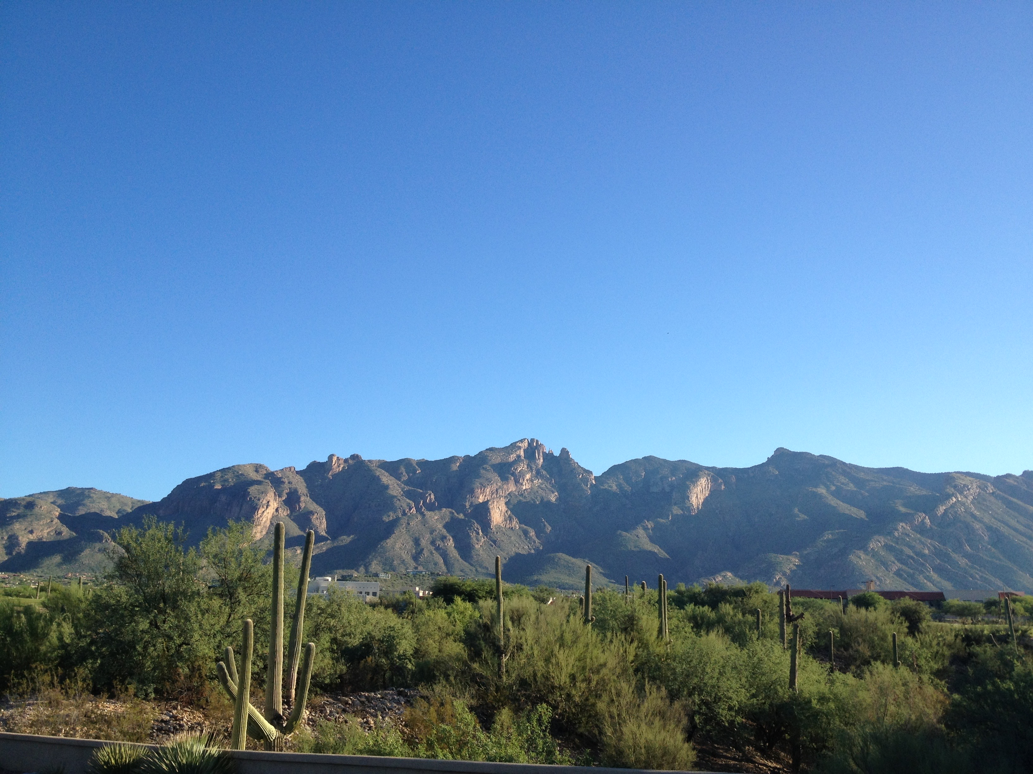

Slide 70
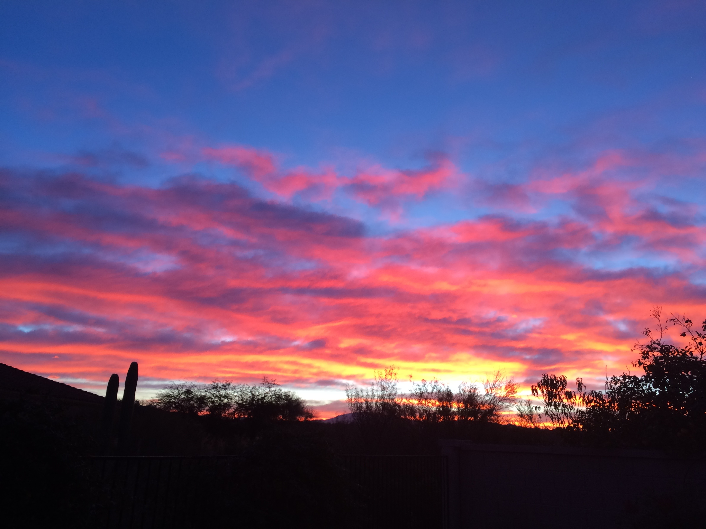

Slide 71
He is most glorified in us
when we are most satisfied
in Him.
Sam Storms

